Slide 1
Azure Machine Learning Studio

Slide 2
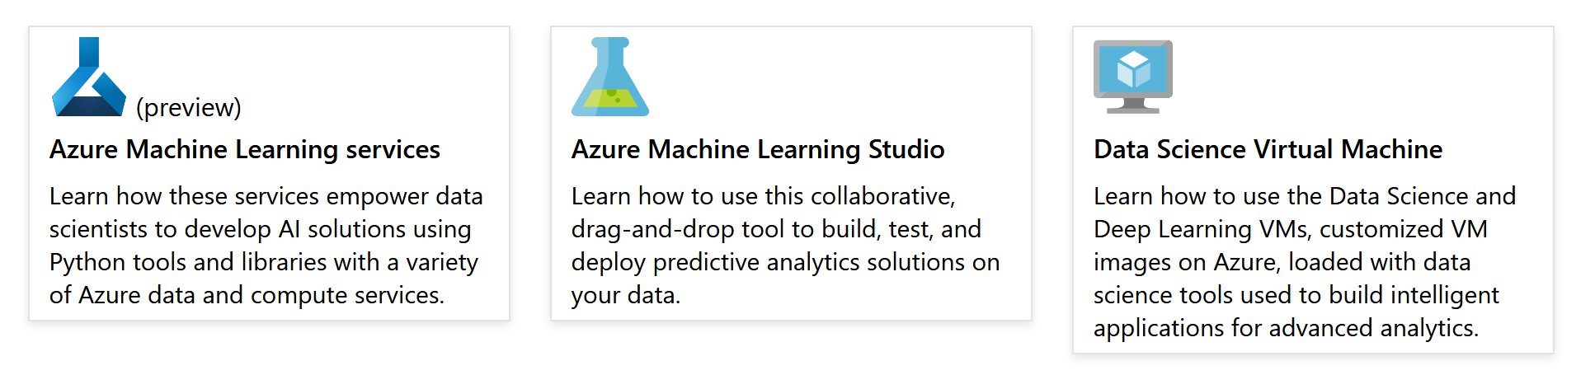
Azure Machine Learning Documentation
https://docs.microsoft.com/en-us/azure/machine-learning/

Slide 3
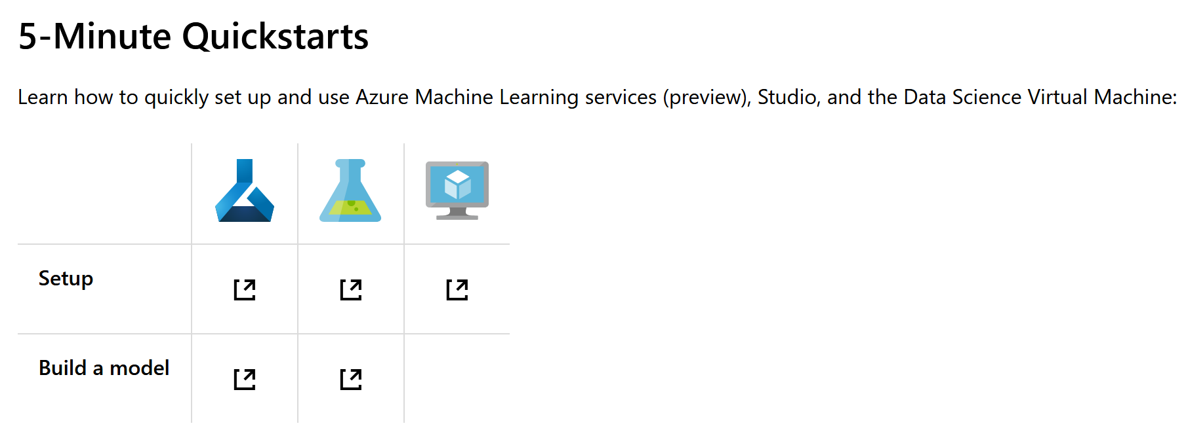
Azure Machine Learning Documentation
https://docs.microsoft.com/en-us/azure/machine-learning/

Slide 4
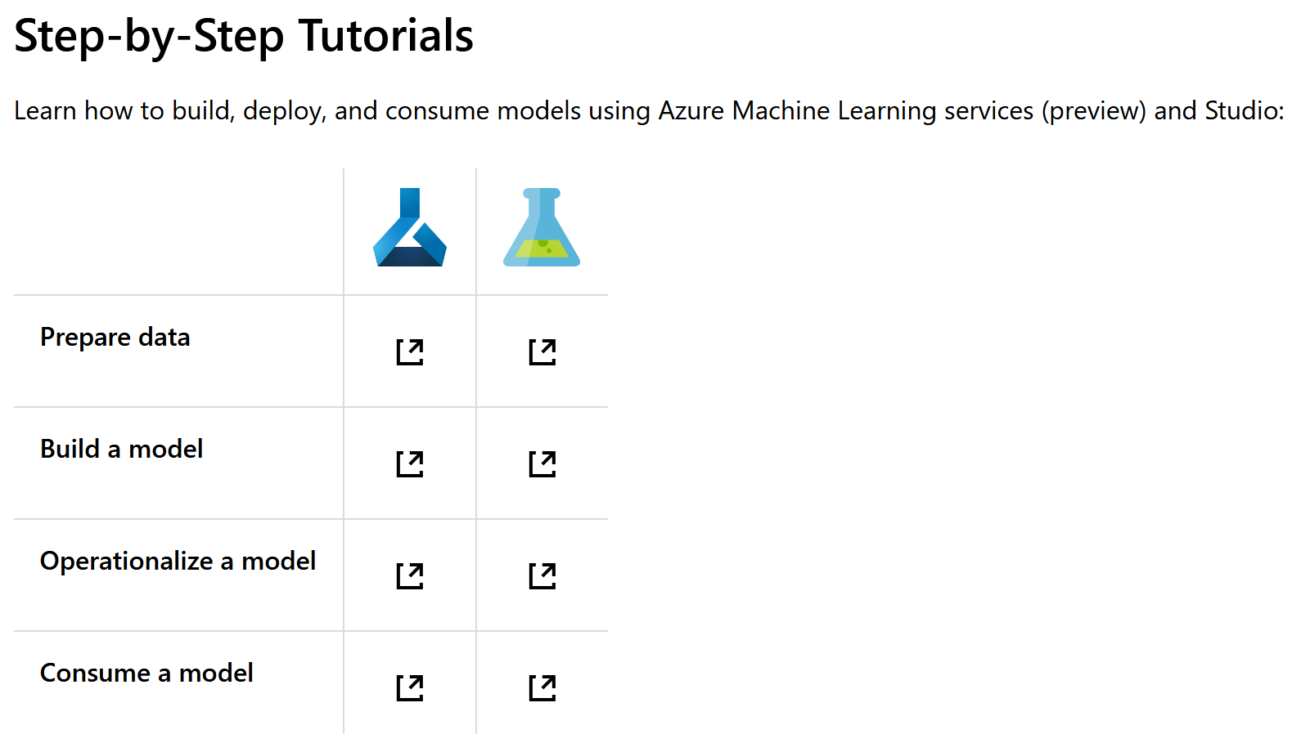
Azure Machine Learning Documentation
https://docs.microsoft.com/en-us/azure/machine-learning/

Slide 5
Introduction to AML Studio
Microsoft Azure Machine Learning Studio is a
collaborative, drag-and-drop tool
you can use to build, test, and deploy predictive analytics solutions on your data.
Machine Learning Studio publishes models as web services
that can easily be consumed by custom apps or BI tools such as Excel.
Machine Learning Studio is where
data science, predictive analytics, cloud resources, and your data meet.

Slide 6
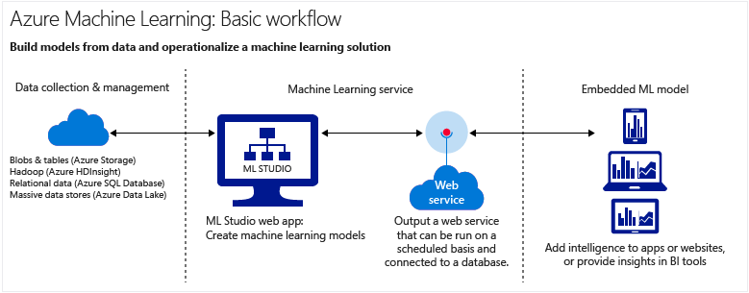
Azure Machine Learning
Data-Warehouse

Slide 7
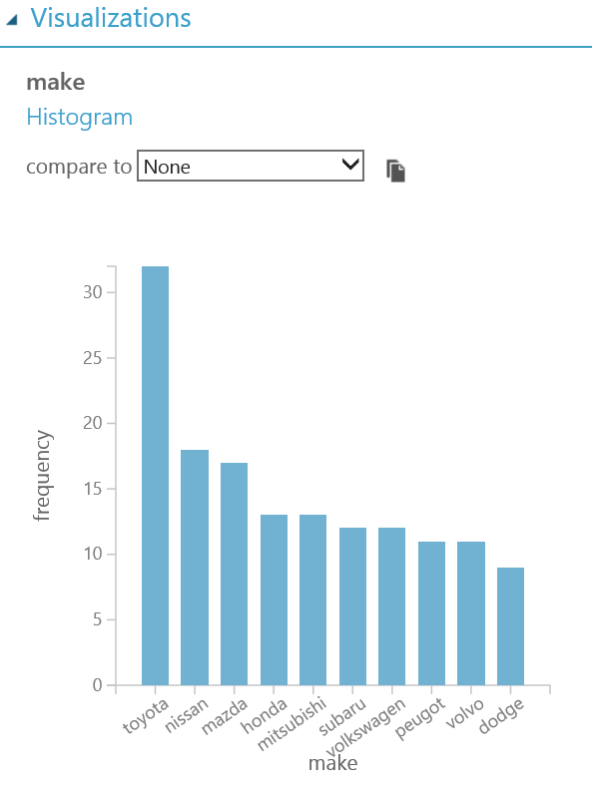
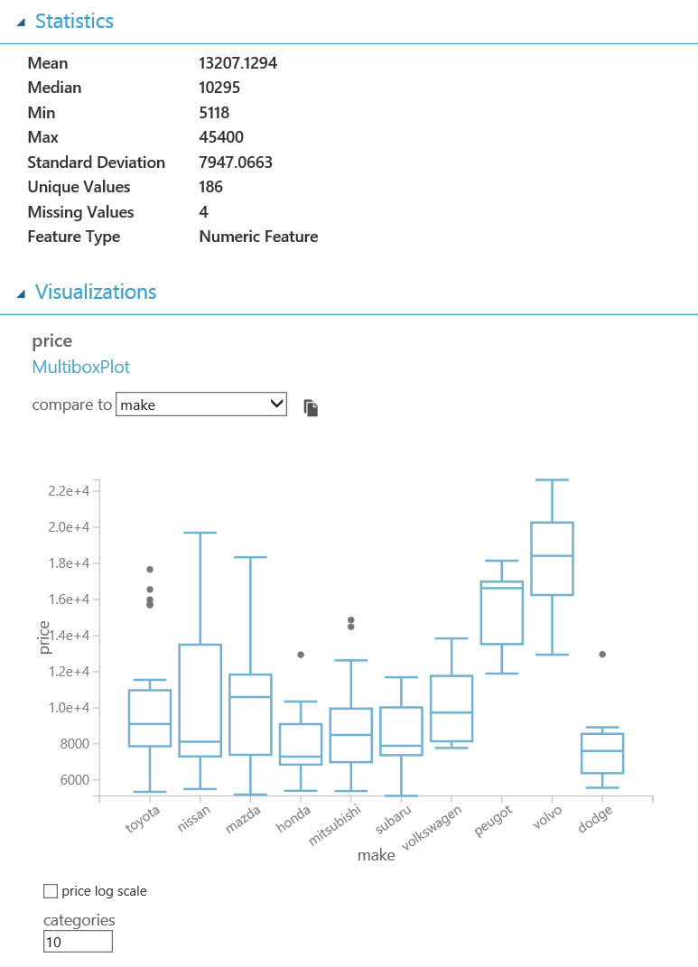
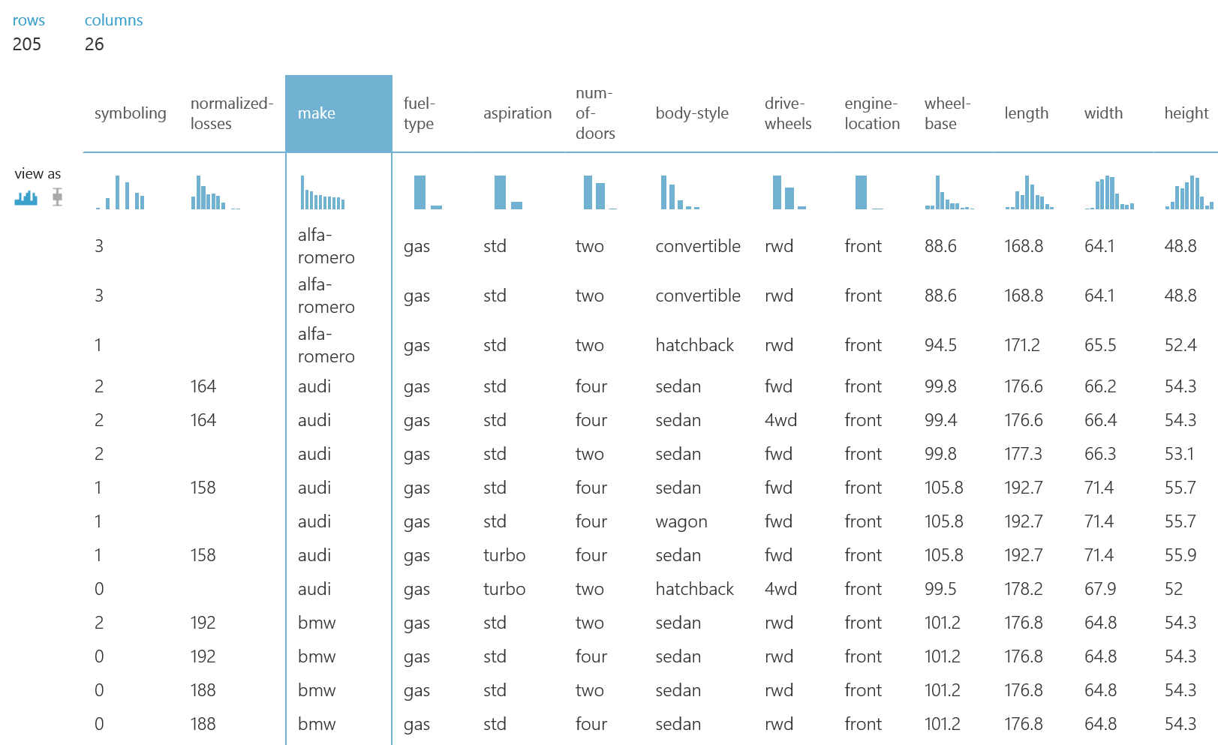
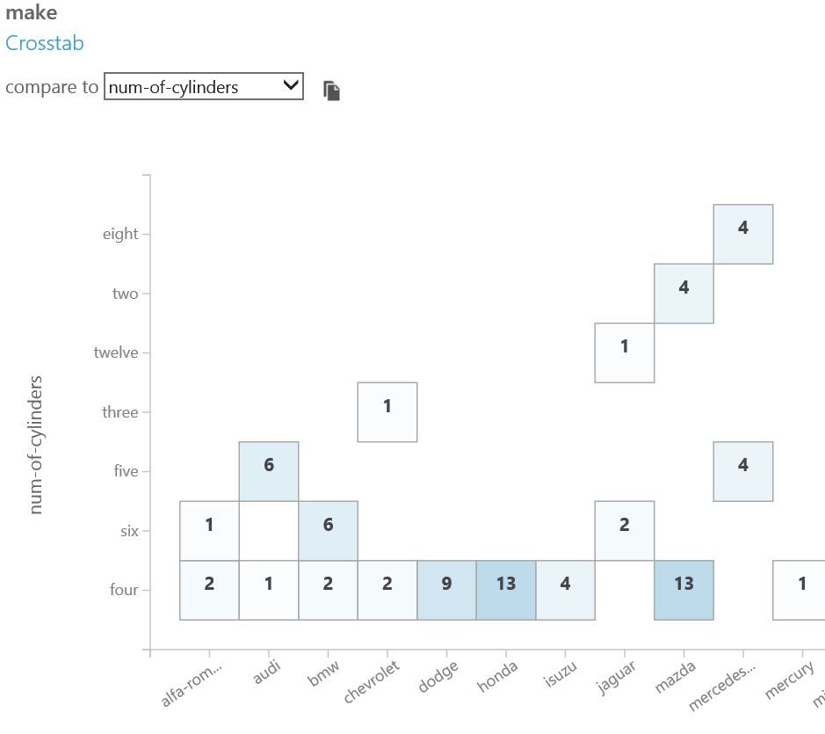
Visualize Data

Slide 8
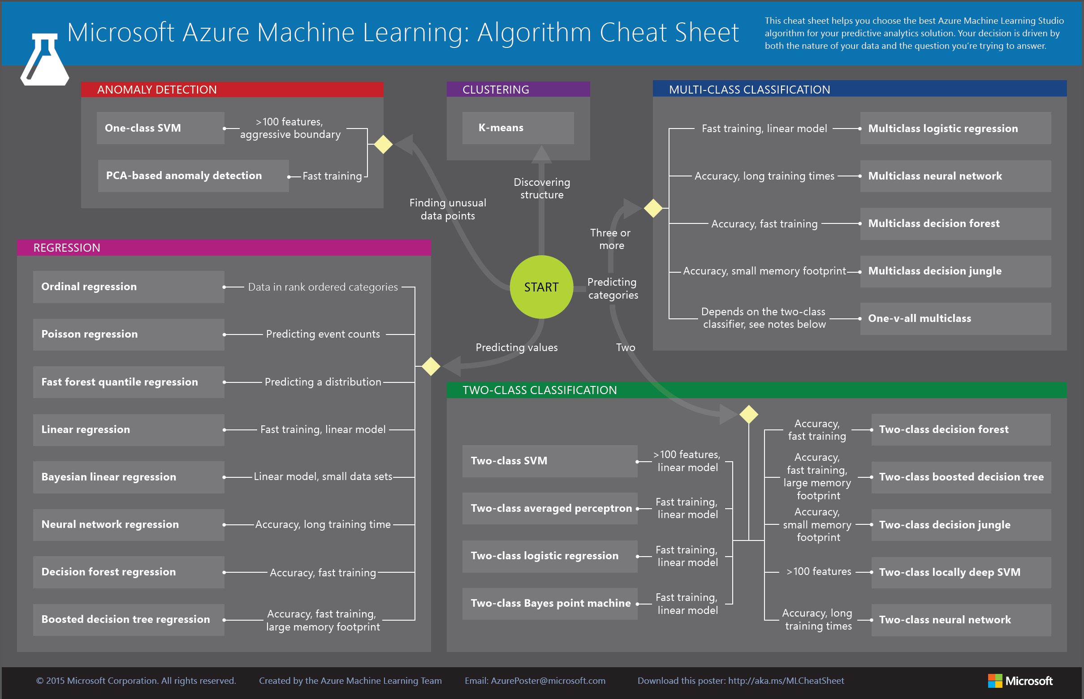
Algorithms for different tasks
test and compare the quality of different algorithms
no mathematical formulars necessary
just necessary to understand how different algorithms work

Slide 9
AML Studio – how to use
Create a Machine Learning workspace
Upload existing data
Create a new experiment
Train and evaluate the models
Deploy the Web service
Access the Web service

Slide 10
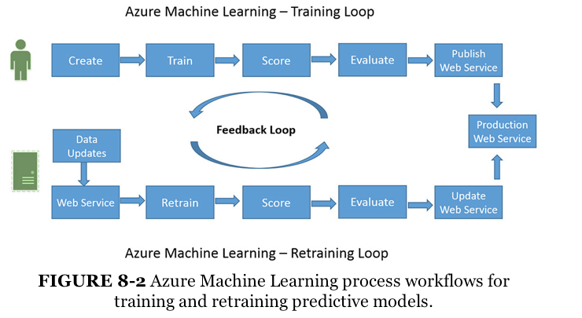
Training Loop / Retraining Loop
Source: „Azure Machine Learning“, Jeff Barnes, ISBN 978-0-7356-9817-9

Slide 11
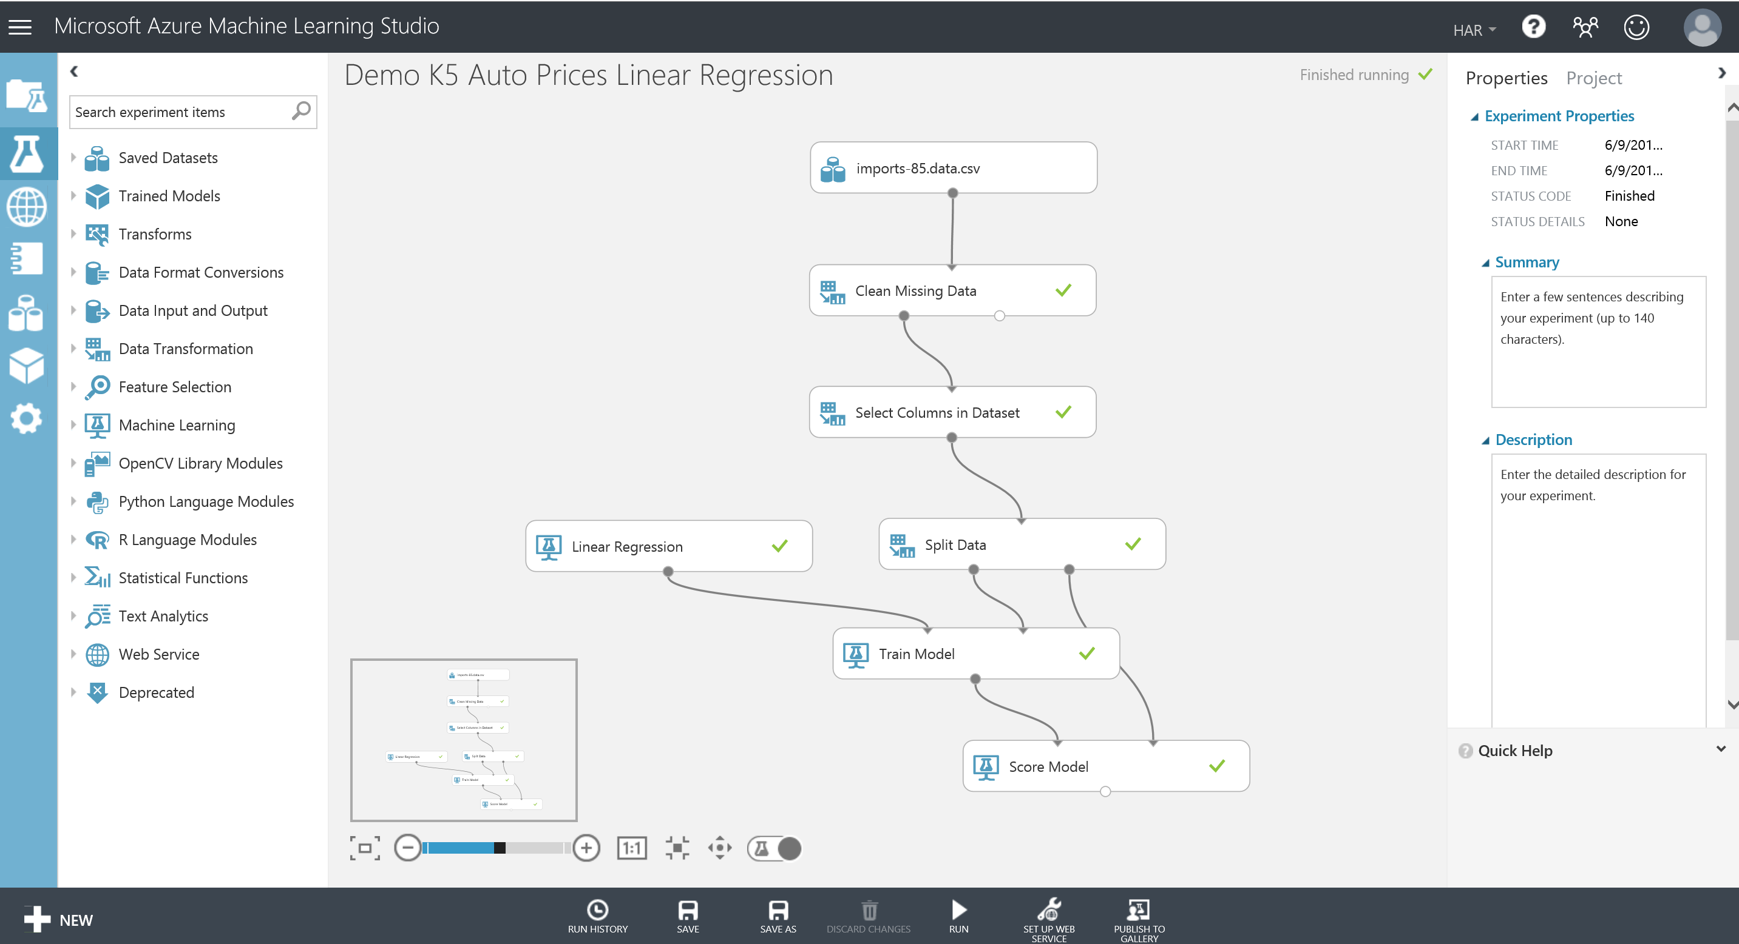
Machine Learning Studio
https://studio.azureml.net
Graphical definition of processing
No installation of software necessary
works with nearly all browsers

Slide 12
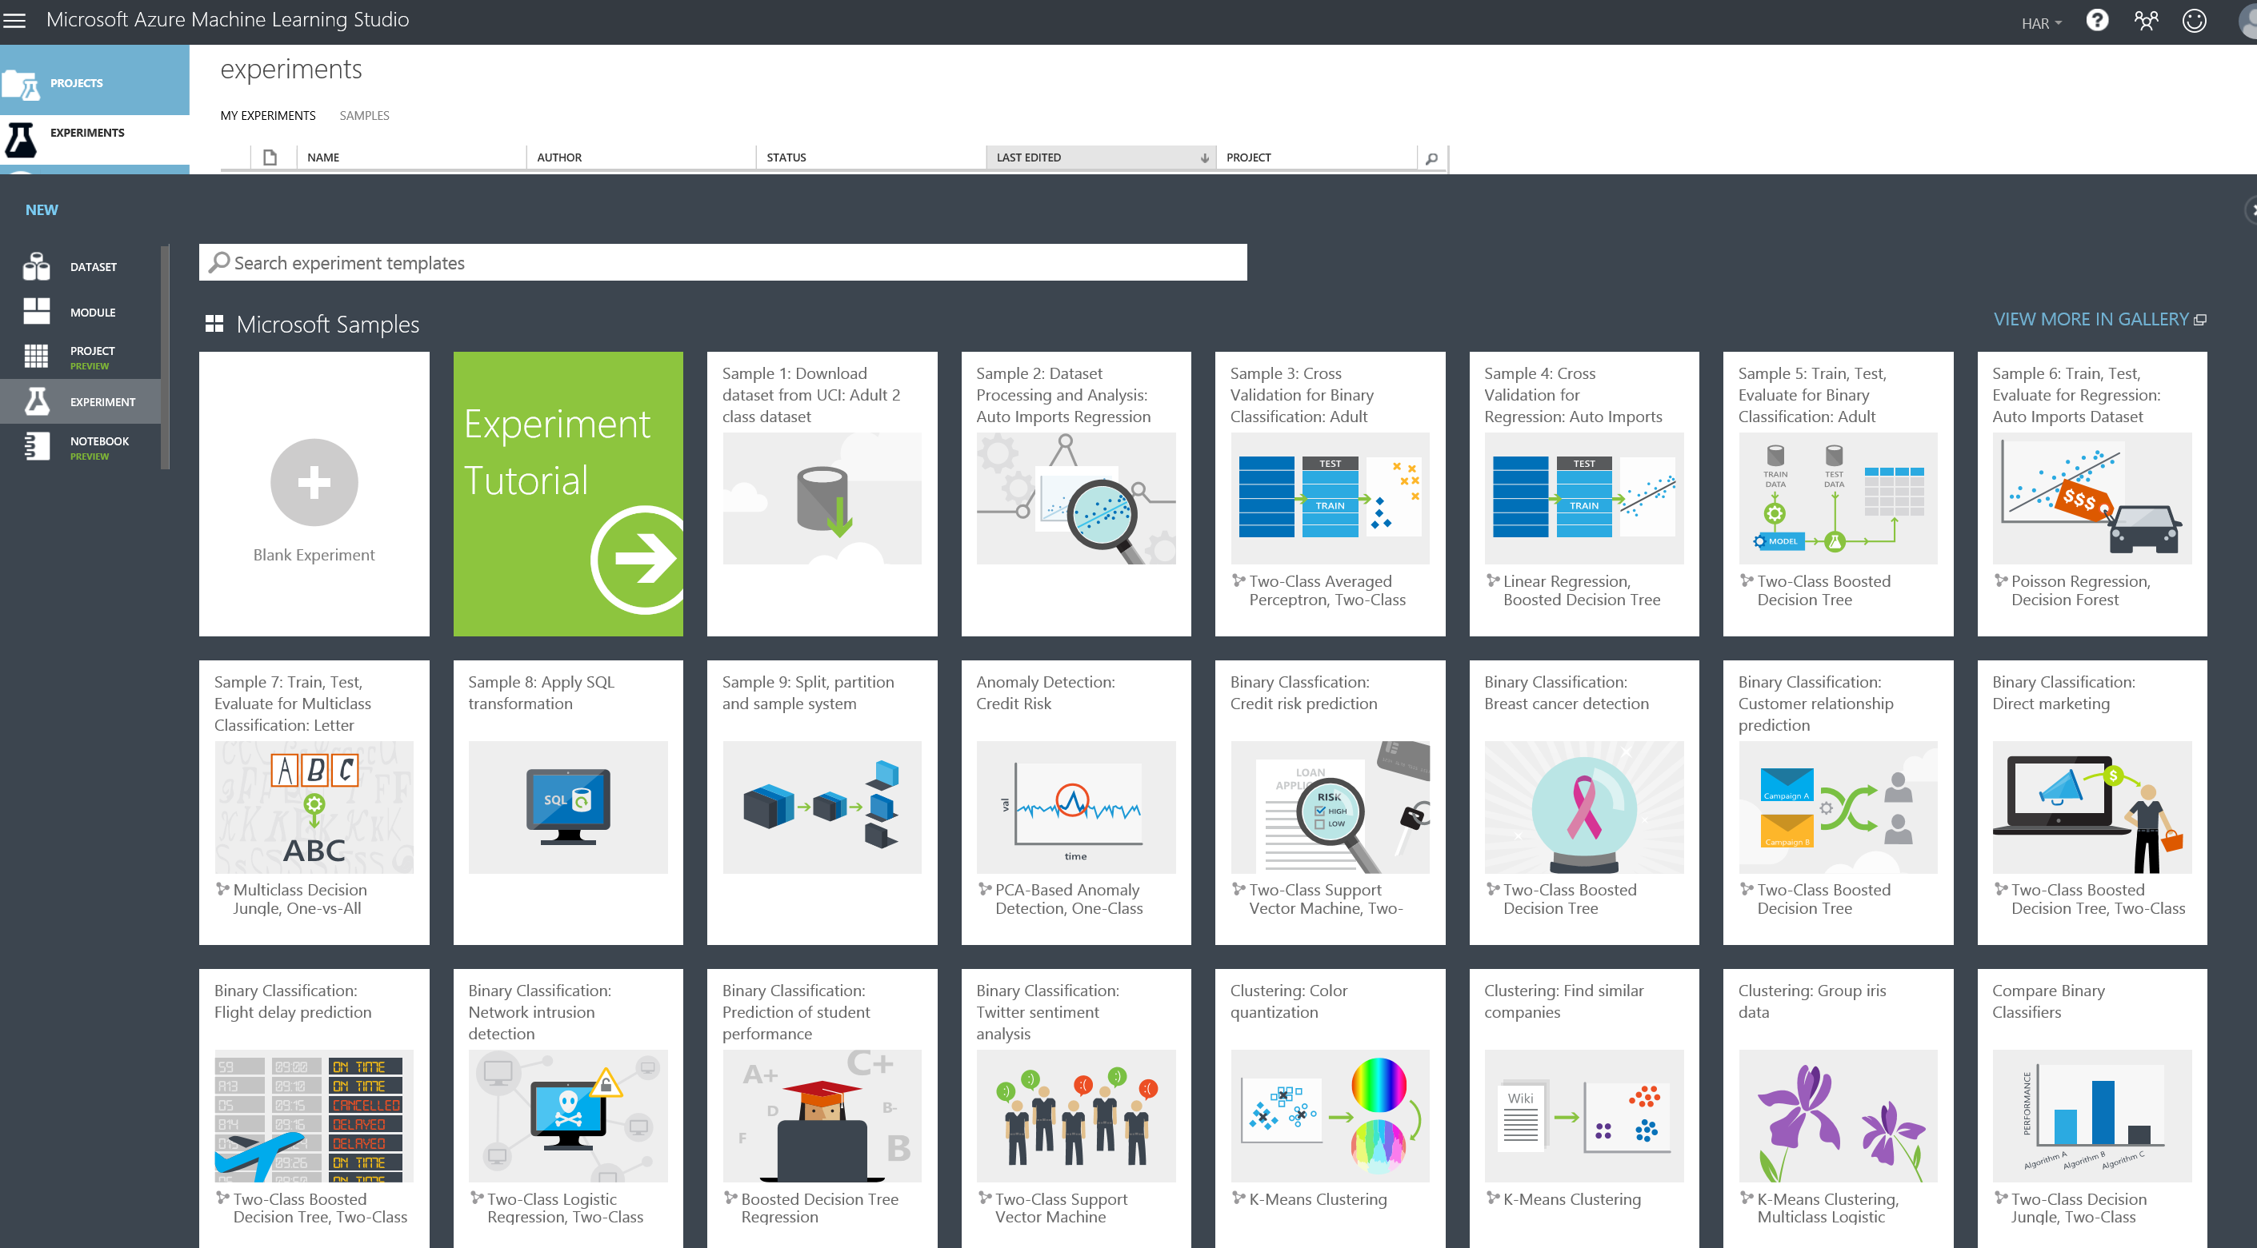
New Experiment / Templates

Slide 13
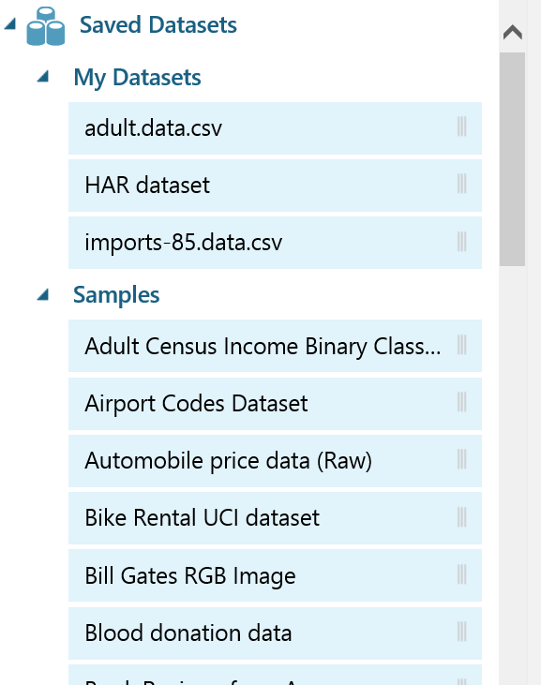
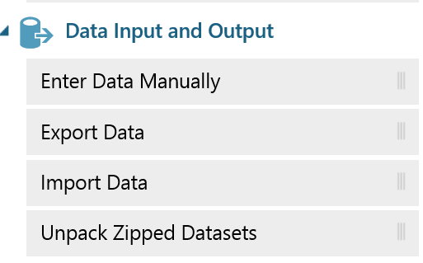
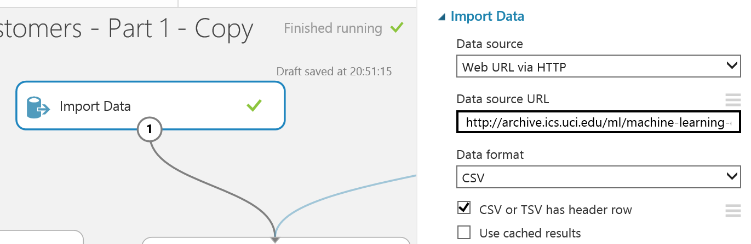
Data-Import direct or viaWebservice
save data in Azure-Cloud
or call Data via Webservice

Slide 14
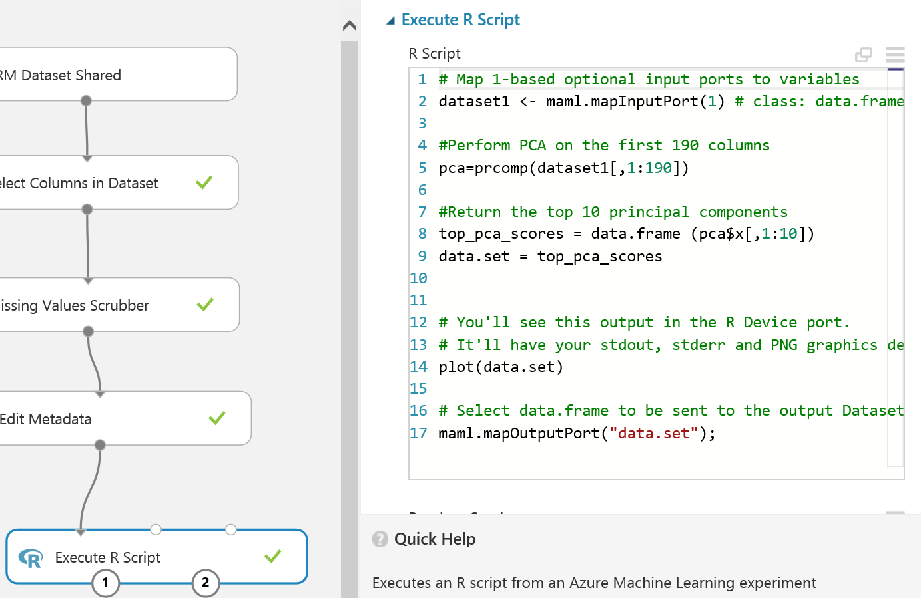
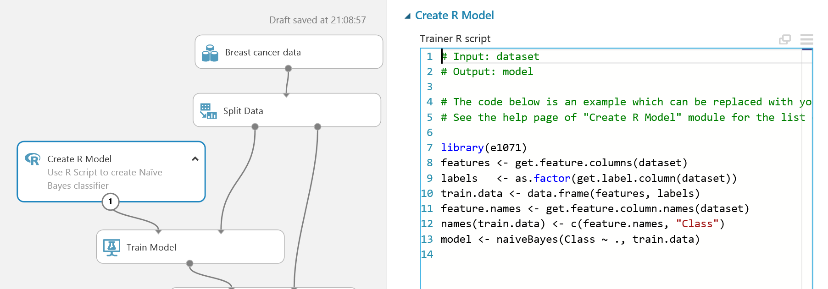
R-Model / Python Model
Integration of R and Python
Use existing module in R or Python
Create and use own Models

Slide 15
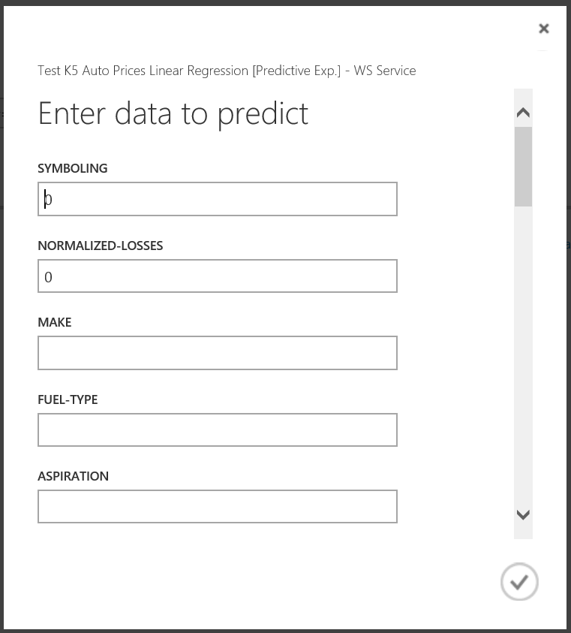
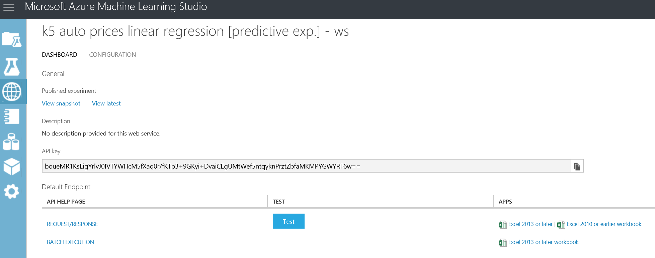
Create Webservice
Manual use of webservices possible (but not comfortable)

Slide 16
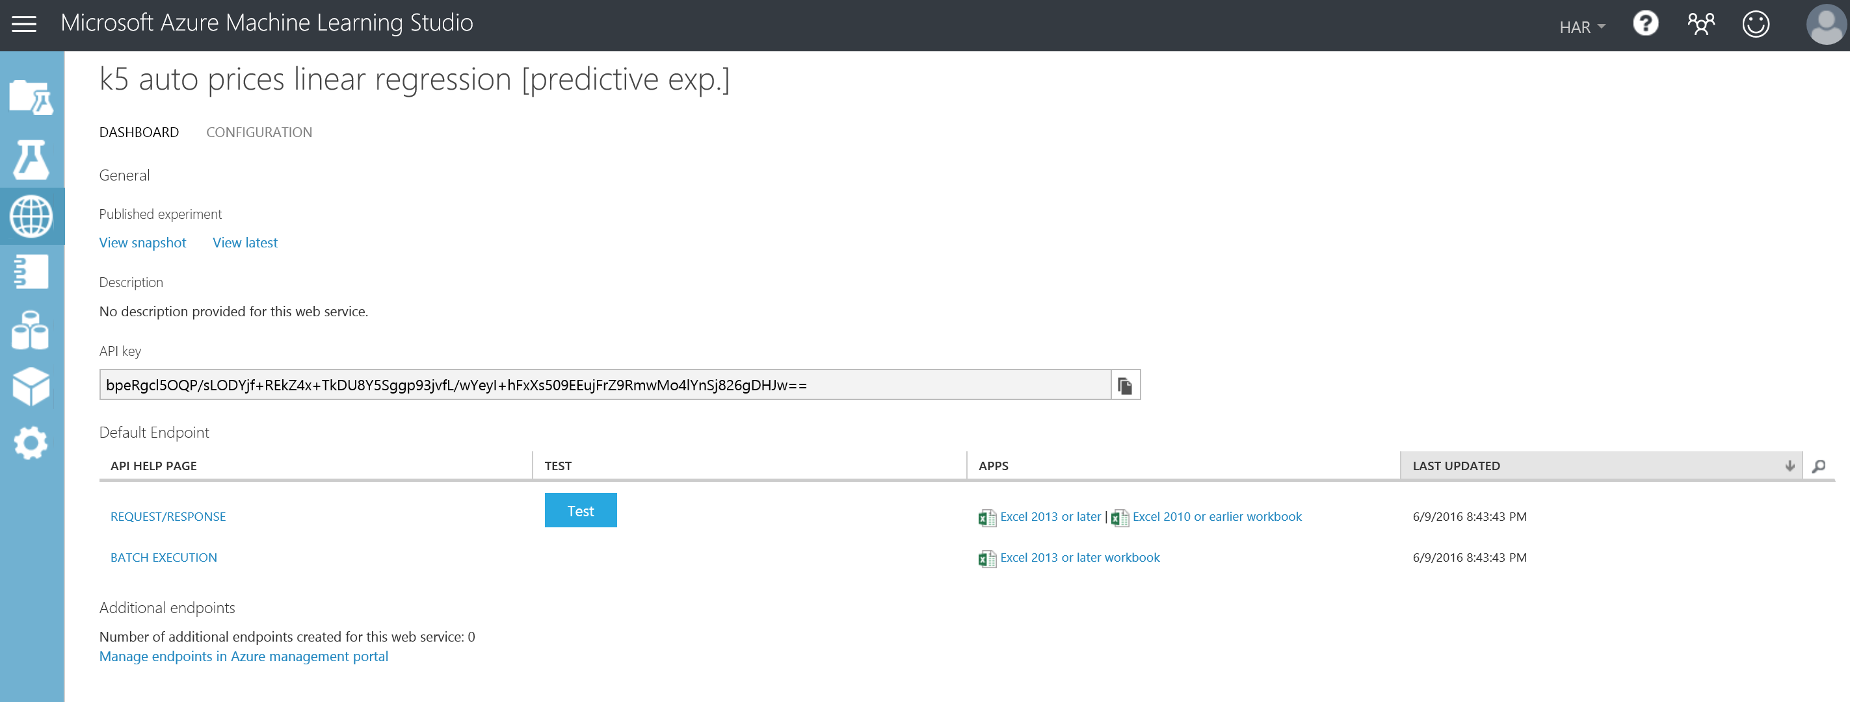
Create Webservice
Excel-Files as client with plugin to consume the created Webservices will be created automatically

Slide 17
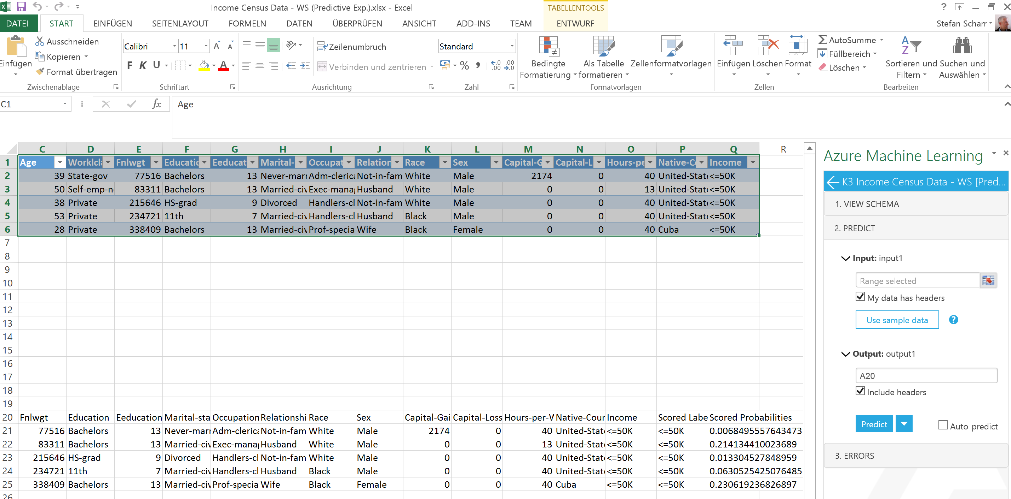
Use Excel to consume Webservices
1 Daten für Prognoseanfrage markieren
2 AddIn- für Excel überträgt Daten an Webservice
3 Webservice sendet Daten inkl. Prognosen zurück ins Excel-Sheet

Slide 18
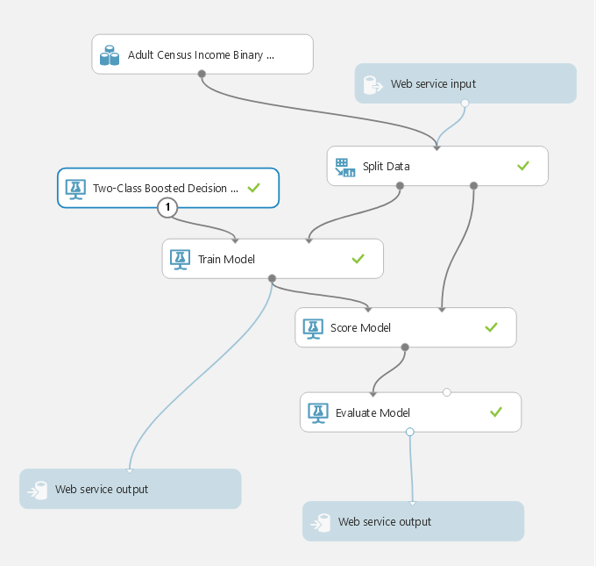
Introduction to AML Studio
Create Models in graphical UI without programming
Create Webservices
Use Webservices from R, Python, C#,…
Use Webservices from Excel (Plugin)

Slide 19
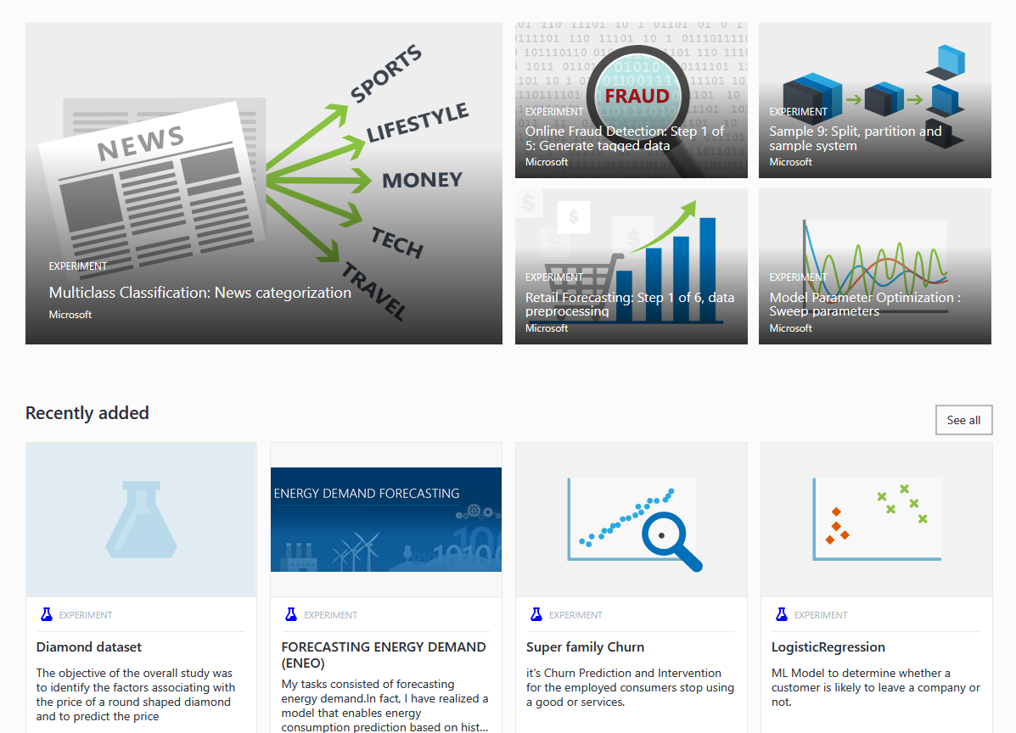
Azure AI Gallery
Lots of models to use as template

Slide 20
Wrap-up
Graphical Configuration of models
Compare quality of different algorithms
Deploy models as Webservice
Use Excel oder individual Software to consume Webservices
No software-installation necessary
no license fee, just pay as much as you use
Monthly billing

